Slide 1


Saldi: Company Overview

Slide 2

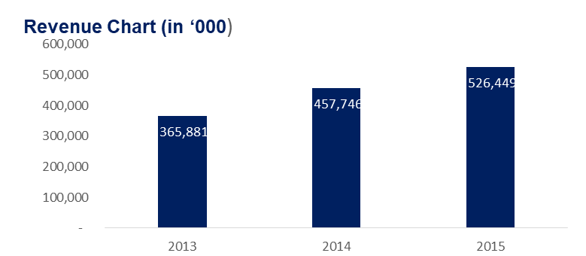
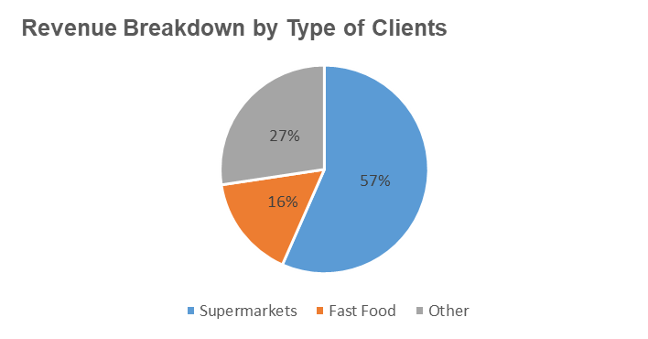
Company Overview
Saldi sells inventory storage systems to large supermarket chains, fast food chains, and other clients, offering them a complete solution.
Headquarters: Denver, Colorado USA
Industry: Inventory Storage
91 employees
CEO: James Scott

Slide 3
Organizational Chart
CEO
Head of Sales
CFO
Head of Product Development
Head of UK Operations
Head of Canada Operations
Head of Australia Operations

Slide 4
2015 P&L

Slide 5
2015 P&L
Revenue increased slightly by 15% whereas Earnings before interest, taxes, depreciation and amortization (EBITDA) recorded a massive growth of 105%.
There was an increase in EBIT, coupled with an increase of total assets. This resulted in a Return on Assets (RoA) of 32%.
The results of Net Income and Total Equity also resulted in a Return on Equity (RoE) of 48%.

Slide 6
2015 Balance Sheet
The Current Ratio of Saldi is 2.97 and is considered good because it is more 2.
With DPO higher than DSO, this indicates that Saldi has a stronger bargaining power.
The Debt Ratio at 0.46 is below the threshold of 0.67 so that’s good.
The Interest Coverage of 24.64 shows that Saldi’s EBIT is almost 25 times its interest expenses, which is reassuring and indicates that the company is unlikely to become insolvent any time soon.

